Slide 1
Power BI Developer in a Day
Courseware authoring and workshop delivery by Ted Pattison and Critical Path Training
Notes:
The first module of this workshop begins with a high-level discussion of how Power BI can serve as a development platform and the instructor walks through setting up a Power BI development environment by creating a new Azure AD tenant with trial Office 365 licenses. While this workshop is not where you'll learn about building projects with Power BI Desktop, the first lecture provides a quick primer on working with PBIX project files and discusses how managing content in a Power BI app workspace is a separate concern from building software projects that consume that content. The modules also provides an introduction to Power BI embedding and explains what you need to understand about Power BI Premium, the Power BI Embedded Service in Microsoft Azure and dedicated capacities.

Slide 2
Agenda
Power BI as a Development Platform
Setting Up a Power BI Dev Environment
Working with Power BI Desktop and PBIX Files
Developing with Power BI Embedding
Understanding Workspaces and Capacities

Slide 3
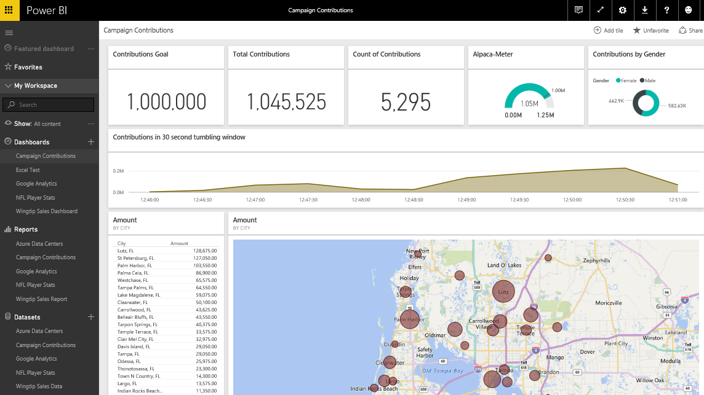
The Power BI Service – Who Is It For?
Provides SaaS service used by web and mobile users
Power BI portal accessible to browsers at https://app.powerbi.com
Power BI mobile accessible to users on mobile phones & devices
Provides PaaS service used by software developers
Power BI Service API accessible at https://api.powerbi.com
Notes:
You can think of the Power BI service as the heart and sole of the Power BI platform. Subscribed users access the Power BI service using any modern browser through its primary URL which is https://app.powerbi.com. Once a user has been authenticated against the common endpoint of https://app.powerbi.com, the users is then connected to the Azure data center which hosts the user’s Power BI workspaces.
Using the browser, a Power BI subscriber can view dashboard and interactive reports. The browser-based experience of the Power BI service also provides support to import datasets and to create reports and dashboards.

Slide 4
Developer Opportunities in Power BI
Developing Custom Visuals
Programming the Power BI Service API
Embedding Reports in Custom Applications
Developing Solutions with Real-time dashboards
Developing Custom Solutions using R
Developing Custom Connectors using M

Slide 5
Agenda
Power BI as a Development Platform
Setting Up a Power BI Dev Environment
Working with Power BI Desktop and PBIX Files
Developing with Power BI Embedding
Understanding Workspaces and Capacities

Slide 6
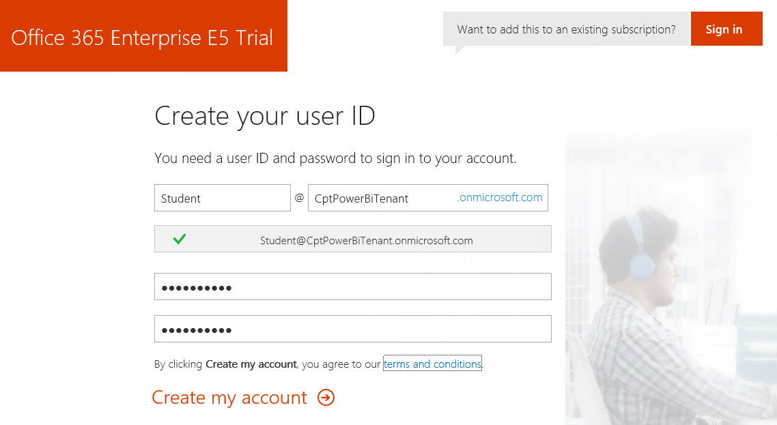
Creating a Power BI Dev Environment
Sign up for an Office 365 Enterprise E5 trial account
Creates a new Office 365 tenant
Creates an account which is tenant administrator
You can create 25 user accounts for testing purposes
Office 365 E5 provides Power BI Pro license
Notes:
In the lab exercises for this course, you will go through the steps to sign up for an Office 365 Enterprise E5 trial account. By doing this you will create a new Office 365 tenant which makes it possible to create multiple user accounts. A key point here is that you are creating a trial account for an entire Office 365 organization as opposed to creating a trial account for a single user.
When you initially create the new Office 365 tenant, you will be prompted to enter the user name and password for a new user account. This initial user account will be created with full tenant administrator capabilities. This means that this accounts with have full administrative control over user management and group management within the Office 365 tenant. This account will also be able to see and modify the organization-wide administrative settings for important cloud services such as Exchange and SharePoint Online.

Slide 7
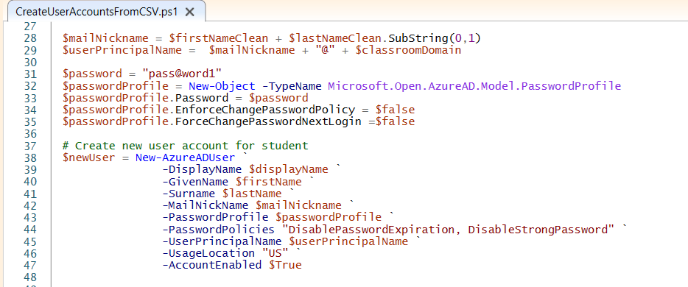
Creating User Accounts for Testing
Can be accomplished in Microsoft 365 Admin center
Can be automated using PowerShell

Slide 8
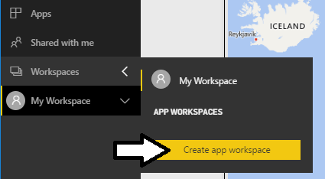
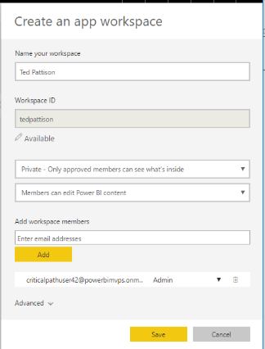
Creating App Workspaces
Power BI content published in app workspaces
Power BI Pro license required to author content in app workspace
Datasets & reports created by publishing PBIX project files
Dashboards must be created by hand

Slide 9
Power BI App Workspaces - V2
Power BI transitioning between workspace models
V2 app workspaces just moved from preview to GA
Microsoft will soon force the migration from V1 to V2
V1 workspaces built on top of Office 365 groups
Largely managed in Office 365 admin not Power BI
V2 workspaces independent of Office 365 groups
Fully managed within Power BI admin portal
Provides more flexibility in assigning members

Slide 10
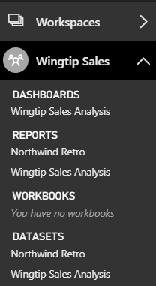
Central Power BI Concepts
Workspace
Secure container for publishing content
Every licensed user gets a personal workspace
App workspaces created for custom solutions
Dashboard
Consolidated view into reports and datasets
Custom solution entry point for mobile users
Report
Collection of pages with tables & visualizations
Provides interactive control of filtering
Dataset
Data model containing one or more tables
Can be very simple or very complex
Notes:
You can think of a workspace as a container that holds three different kinds of assets; dashboards, reports and datasets. Every dashboard, report and dataset created in Power BI must be created within the scope of a specific workspace. A workspace also provides a user context because the current workspace always determines which set of dashboards, reports and datasets are visible to the user.
Every Power BI subscriber has a personal workspace which is named My Workspace. An organization can also create group workspaces which make it possible to achieve team-based authoring and staged deployment of custom solutions. The course will go into greater detail on working with group workspaces later in module 7 when discussing how to deploy dashboards.
A dashboard typically serves as the top-level entry point into a custom data analytics solution. In Power BI, a dashboard is created as a consolidated view on top of reports and datasets. Dashboard are also important to Power BI mobile users because there display is often optimized for mobiles devices such as iPhones, Android phones and Windows 10 phone.
A report is a collection of pages that is associated with exactly one underlying dataset. Each page in a report serves as a canvas on which you can add tables, matrices and other types of visualizations. While dashboards are designed to provide a high-level overview, reports are the opposite because they are used to drill down into the lower-level details. Reports also provide much more interactive filtering control for custom solutions in which the user must be given the ability to drill down into further levels of detail.
A dataset is a collection of one of more tables that defines a data model. A simple dataset can contain a single table with three columns and ten rows. However, a dataset often contains multiple tables which has relationships between them. In the upcoming lab exercises in this course, you will design a dataset using all the different query and data modeling features of Power BI Desktop.

Slide 11
Agenda
Power BI as a Development Platform
Setting Up a Power BI Dev Environment
Working with Power BI Desktop and PBIX Files
Developing with Power BI Embedding
Understanding Workspaces and Capacities

Slide 12
Working with Power BI Desktop
Power BI Desktop focuses on first four phases
Query features for Data Discovery
Query features for ETL
Design features and DAX language for data modeling
Report design using a visual report designer
No support for designing dashboards
No support for packaging an entire solution
Assistance from Power BI Desktop
Data Discovery
ELT
Data Modeling
Design Reports
Design Dashboards
Deploy Dashboards
Notes:
Power BI Desktop doesn’t do everything. Instead, it focuses on the first four phases of creating a custom BI solution.
When you begin a project in the data discovery phase, Power BI Desktop is an excellent tool to begin inspecting different forms of data and to assess how useable and useful that data might be to the project. Once you have determined what data you need to work with, the powerful and easy-to-use query features of Power BI Desktop will take you through the ETL phase. Power BI Desktop also provides a rich set of features for modeling data and designing reports.
Currently, Power BI Desktop provides no support for designing dashboards. Once you have designed a data model and a report in a local Power BI Desktop project and then you have published the project to the Power BI service, you will use a browser to complete the final steps of designing a dashboard and deploying all your work using dashboard sharing or an organizational content pack.

Slide 13
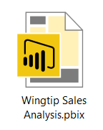
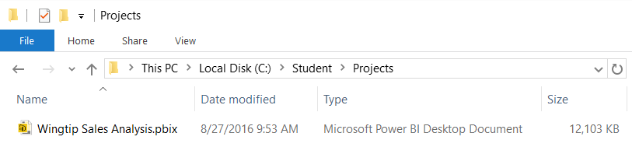
Power BI Desktop Projects and PBIX Files
Power BI Desktop projects saved using PBIX files
PBIX file contains data source definitions
PBIX file contains query definitions
PBIX file contains data imported from queries
PBIX file contains exactly one data model definition
PBIX file contains exactly one report
PBIX file never contains data source credentials
PBIX files can be tracked in source control (e.g. github.com)
PBIX files is a versioned unit of work with 1 dataset and 1 report
Some Power BI resources (e.g. Dashboard) have no backing file support
Notes:
Power BI Desktop projects are saved, loaded and published using PBIX files. A PBIX file is a ZIP archive created using the Open Packaging Convention format just like common Office documents such as DOCX files and XLSX files. The files for datasets that are stored inside and loaded from a PBIX file are managed internally by Power BI Desktop using Microsoft’s xVelocity Tabular database engine.
Each project created using Power BI Desktop is stored as a single PBIX file. Just about everything you create and configure when using Power BI Desktop is stored inside the PBIX file for one specific project. A PBIX file stores data source definitions and query definitions as well as tables of data which are populated and refreshed when queries are executed. A PBIX files also includes all the work you have done with data modeling and report design.
From a project management perspective, it’s important to understand that a PBIX file represents a single project which contains exactly one dataset and exactly one report. You cannot add a second report to a Power BI Desktop project. However, you can add as many pages as you would like to a project’s one and only report.
You should take note that Power BI Desktop will never store data source credentials in a PBIX file. For example, PBIX files never contain the user name and password required to access a secured resource such as a Online service or an on-premises SQL server database. Instead, Power BI Desktop provides the convenience of storing data source credentials in a local cache so you are not required to continually log into the same data source when working with Power BI Desktop. But these credentials are never published along with a PBIX file. After you publish a Power BI Desktop project by uploading its PBIX file, you will be required to configure data source credentials separately using the browser or by using some other automated technique.

Slide 14


Division of Labor with Power BI Embedding
Content Management Team
Build Power BI Desktop projects
Publish reports & datasets via PBIX files
Create dashboards in PBI Service
Publish App Workspaces as Apps
Monitor Power BI environment
Application Development Team
Develop web apps with PBI embedding
Authenticate with Azure Active Directory
Retrieve data using Power BI Service API
Embed resources using Power BI JavaScript API
This team sees PBIX files as black boxes

Slide 15
Agenda
Power BI as a Development Platform
Setting Up a Power BI Dev Environment
Working with Power BI Desktop and PBIX Files
Developing with Power BI Embedding
Understanding Workspaces and Capacities

Slide 16
Power BI Embedding – The Big Picture
User launches your app using a browser
App authenticates with Azure Active Directory and obtains access token
App uses access token to call to Power BI Service API
App retrieves data for embedded resource and passes it to browser.
Client-side code uses Power BI JavaScript API to create embedded resource
Embedded resource session created between browser and Power BI service
5
Power BI Service
Browser
iFrame
6
4
4
3
1
Your App
2
Azure AD

Slide 17
First Party Embedding vs Third Party Embedding
First Party Embedding
Known as User-Owns-Data Model
All users require a Power BI license
Useful in corporate environments
App authenticates as current user
Your code runs with user’s permissions
User’s access token passed to browser
Third Party Embedding
Known as App-Owns-Data Model
No users require Power BI license
Useful for commercial applications
App authenticates to acquire app-only token
Your code runs with admin permissions
Embed token passed to browser
First Party Embedding for use within Organization
Third Party Embedding for use by ISVs
Browser
Power BI Service
Browser
Power BI Service
iFrame
iFrame
Azure AD
Access Token
for the current user
Power BI
Embed Token
for specific report

Slide 18
Embeddable Resources
Reports
Dashboards
Dashboard Tiles
New Reports
Q&A Experience
Visuals in custom layout

Slide 19
Embeddable Resources

Slide 20
Agenda
Power BI as a Development Platform
Setting Up a Power BI Dev Environment
Working with Power BI Desktop and PBIX Files
Developing with Power BI Embedding
Understanding Workspaces and Capacities

Slide 21
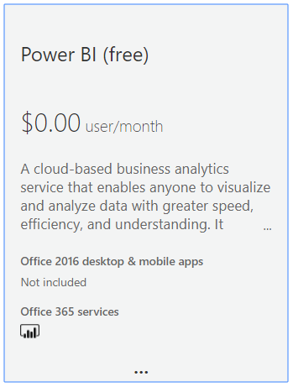
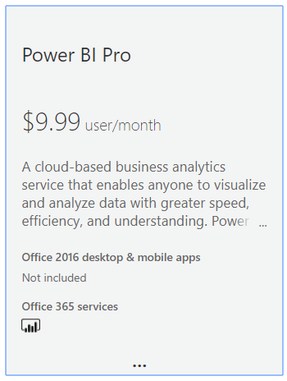
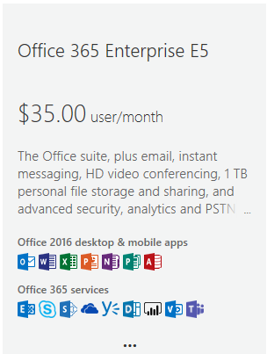
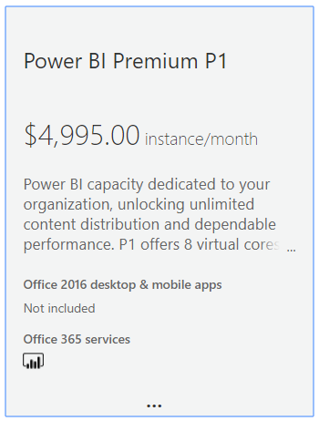
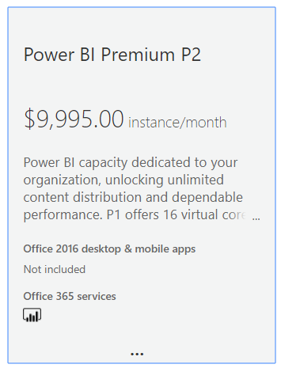
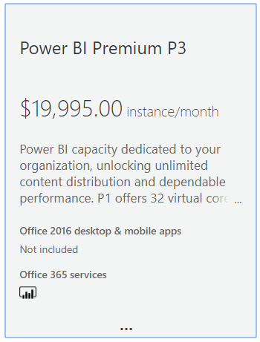
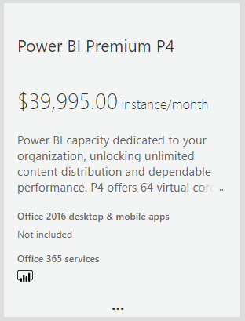
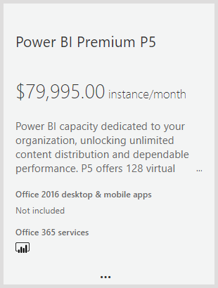
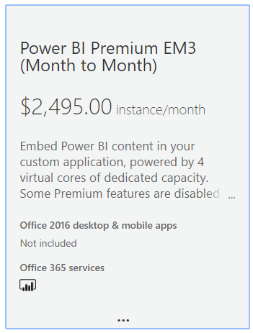
Power BI Licensing Though Office 365
User-based licensing
Capacity-based Licensing

Slide 22
Capacities and Workspace Associations
Every Power BI workspace runs in the context of a capacity
By default, app workspaces and personal workspace run in shared capacity
Organizations have the option of purchasing dedicated capacities
Shared Capacity
Dedicated Capacity
Dedicated Capacity
App Workspace
App Workspace
App Workspace
App Workspace
Dashboards
Dashboards
Dashboards
Dashboards
Reports
Reports
Reports
Reports
Datasets
Datasets
Datasets
Datasets
Dataflows
Dataflows
Dataflows
Dataflows
App Workspace
App Workspace
Dashboards
Dashboards
Reports
Reports
Datasets
Datasets
Dataflows
Dataflows
Notes:
You can think of a workspace as a container that holds three different kinds of assets; dashboards, reports and datasets. Every dashboard, report and dataset created in Power BI must be created within the scope of a specific workspace. A workspace also provides a user context because the current workspace always determines which set of dashboards, reports and datasets are visible to the user.
Every Power BI subscriber has a personal workspace which is named My Workspace. An organization can also create group workspaces which make it possible to achieve team-based authoring and staged deployment of custom solutions. The course will go into greater detail on working with group workspaces later in module 7 when discussing how to deploy dashboards.
A dashboard typically serves as the top-level entry point into a custom data analytics solution. In Power BI, a dashboard is created as a consolidated view on top of reports and datasets. Dashboard are also important to Power BI mobile users because there display is often optimized for mobiles devices such as iPhones, Android phones and Windows 10 phone.
A report is a collection of pages that is associated with exactly one underlying dataset. Each page in a report serves as a canvas on which you can add tables, matrices and other types of visualizations. While dashboards are designed to provide a high-level overview, reports are the opposite because they are used to drill down into the lower-level details. Reports also provide much more interactive filtering control for custom solutions in which the user must be given the ability to drill down into further levels of detail.
A dataset is a collection of one of more tables that defines a data model. A simple dataset can contain a single table with three columns and ten rows. However, a dataset often contains multiple tables which has relationships between them. In the upcoming lab exercises in this course, you will design a dataset using all the different query and data modeling features of Power BI Desktop.

Slide 23
Dedicated Capacities
Power BI workspaces run in one of two possible environments
Shared capacity
Dedicated capacity
Dedicated capacity required for third party embedding
You pay Microsoft capacity-based fee for processors cores and RAM
No need to pay Microsoft for user licensing
Dedicated capacity can be used for first party embedding
Allows users to have free license instead of Power BI Pro license
Dedicated capacities come in two flavors
Power BI Premium capacities purchased through Office 365
Power BI Embedded capacities purchased through Azure SKU

Slide 24
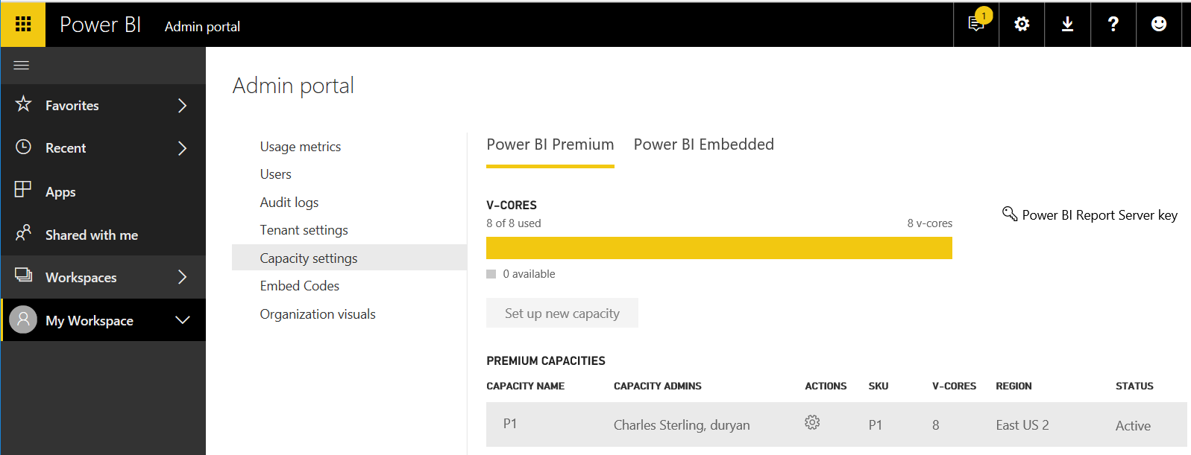
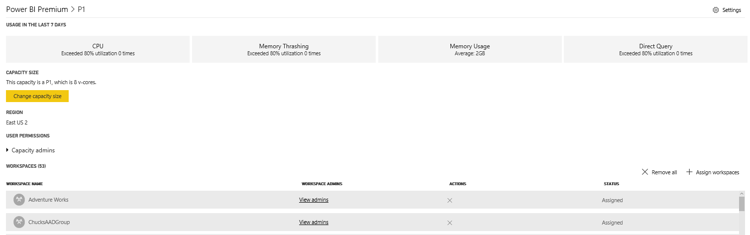
Managing Premium Capacities
Dedicated capacities managed in Power BI Admin portal

Slide 25
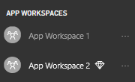
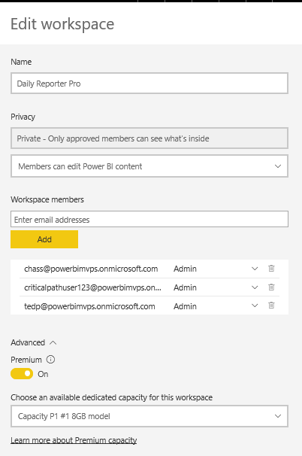
Associating App Workspaces with a Capacity
App Workspace in Premium Capacity has diamond icon
App workspace moved into Premium capacity in Advanced settings
Inside Shared Capacity
Inside Premium Capacity

Slide 26
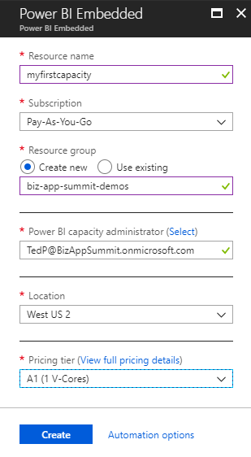
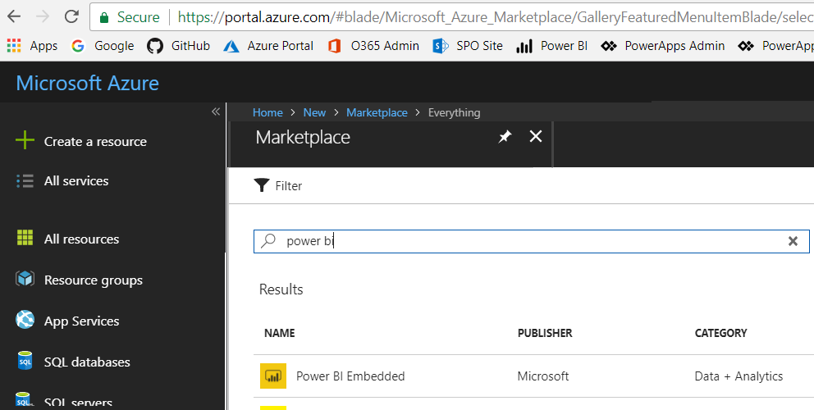
Creating the Power BI Embedded Service
Power BI Embedded in an Azure on-demand service
Must be created in same location as Power BI Service for tenant
Can be created manually through the Azure portal
Can be created in automated fashion using PowerShell
Requires an Azure subscription in same tenant

Slide 27
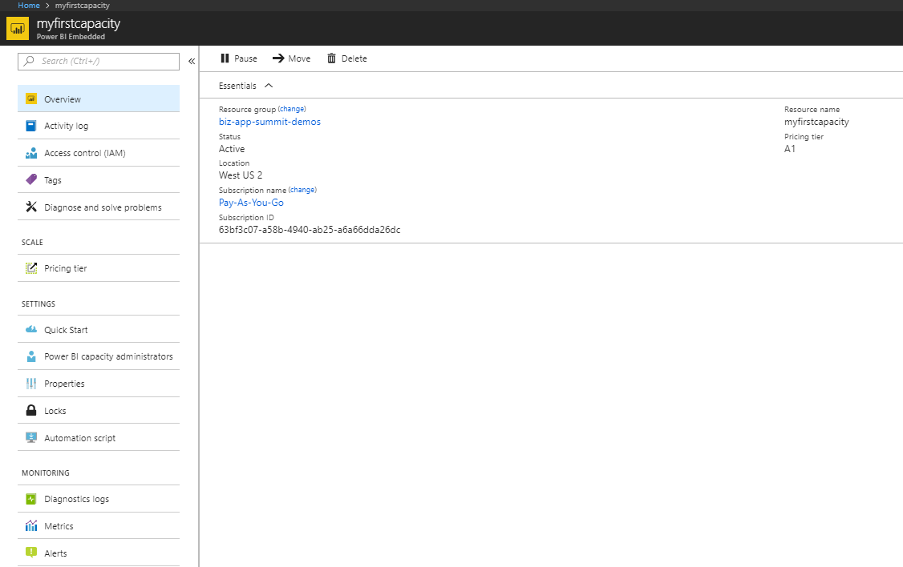
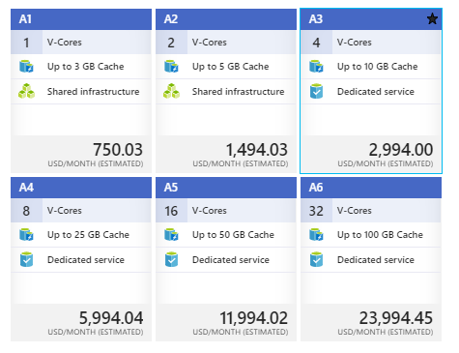
Embedded Capacity Pricing Tiers

Slide 28
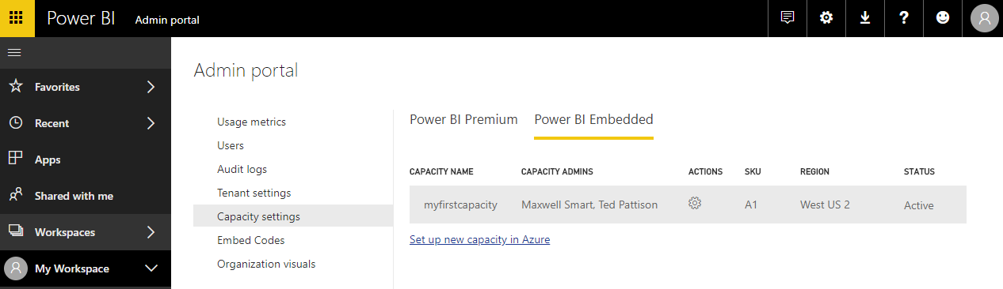
Managing Power BI Embedded Capacities
Managing Power BI Embedded capacity done Azure portal
Use Azure portal to assign administrators & change pricing tier to scale
Managing Power BI Embedded capacity in Power BI Admin portal
Power BI Admin portal to assign workspaces to capacities

Slide 29
PBI Capacity SKU Decoder Ring
 | P SKU | EM SKU | A SKU
Purchased through… | Office 365 | Office 365 | Azure
Supports Power BI embedding in custom applications | Yes | Yes | Yes
Supports 3rd Party Embedding in custom applications | Yes | Yes | Yes
Supports 1st Party Embedding in custom applications | Yes | Yes | Yes
Supports free users accessing content in Power BI portal | Yes | No | No
Supports free users accessing content in Power BI Mobile | Yes | No | No
Billing cycle | Monthly | Monthly | Hourly
Commitment | Monthly | Monthly/Yearly | None
Turn it off when your not using it | No | No | Yes

Slide 30
Summary
Power BI as a Development Platform
Setting Up a Power BI Dev Environment
Working with Power BI Desktop and PBIX Files
Developing with Power BI Embedding
Understanding Workspaces and Capacities

